Slide 1
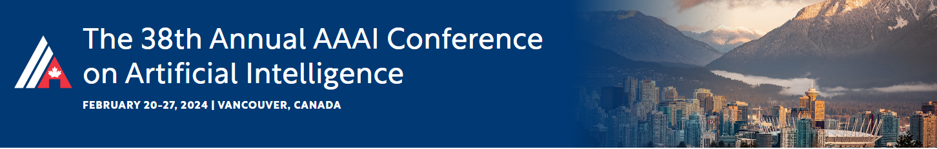




Feature Fusion from Head to Tail for Long-Tailed Visual Recognition
Mengke Li, Zhikai Hu, Yang Lu, Weichao Lan, Yiu-ming Cheung, Hui Huang*
Reported by Mengke Li

Slide 2
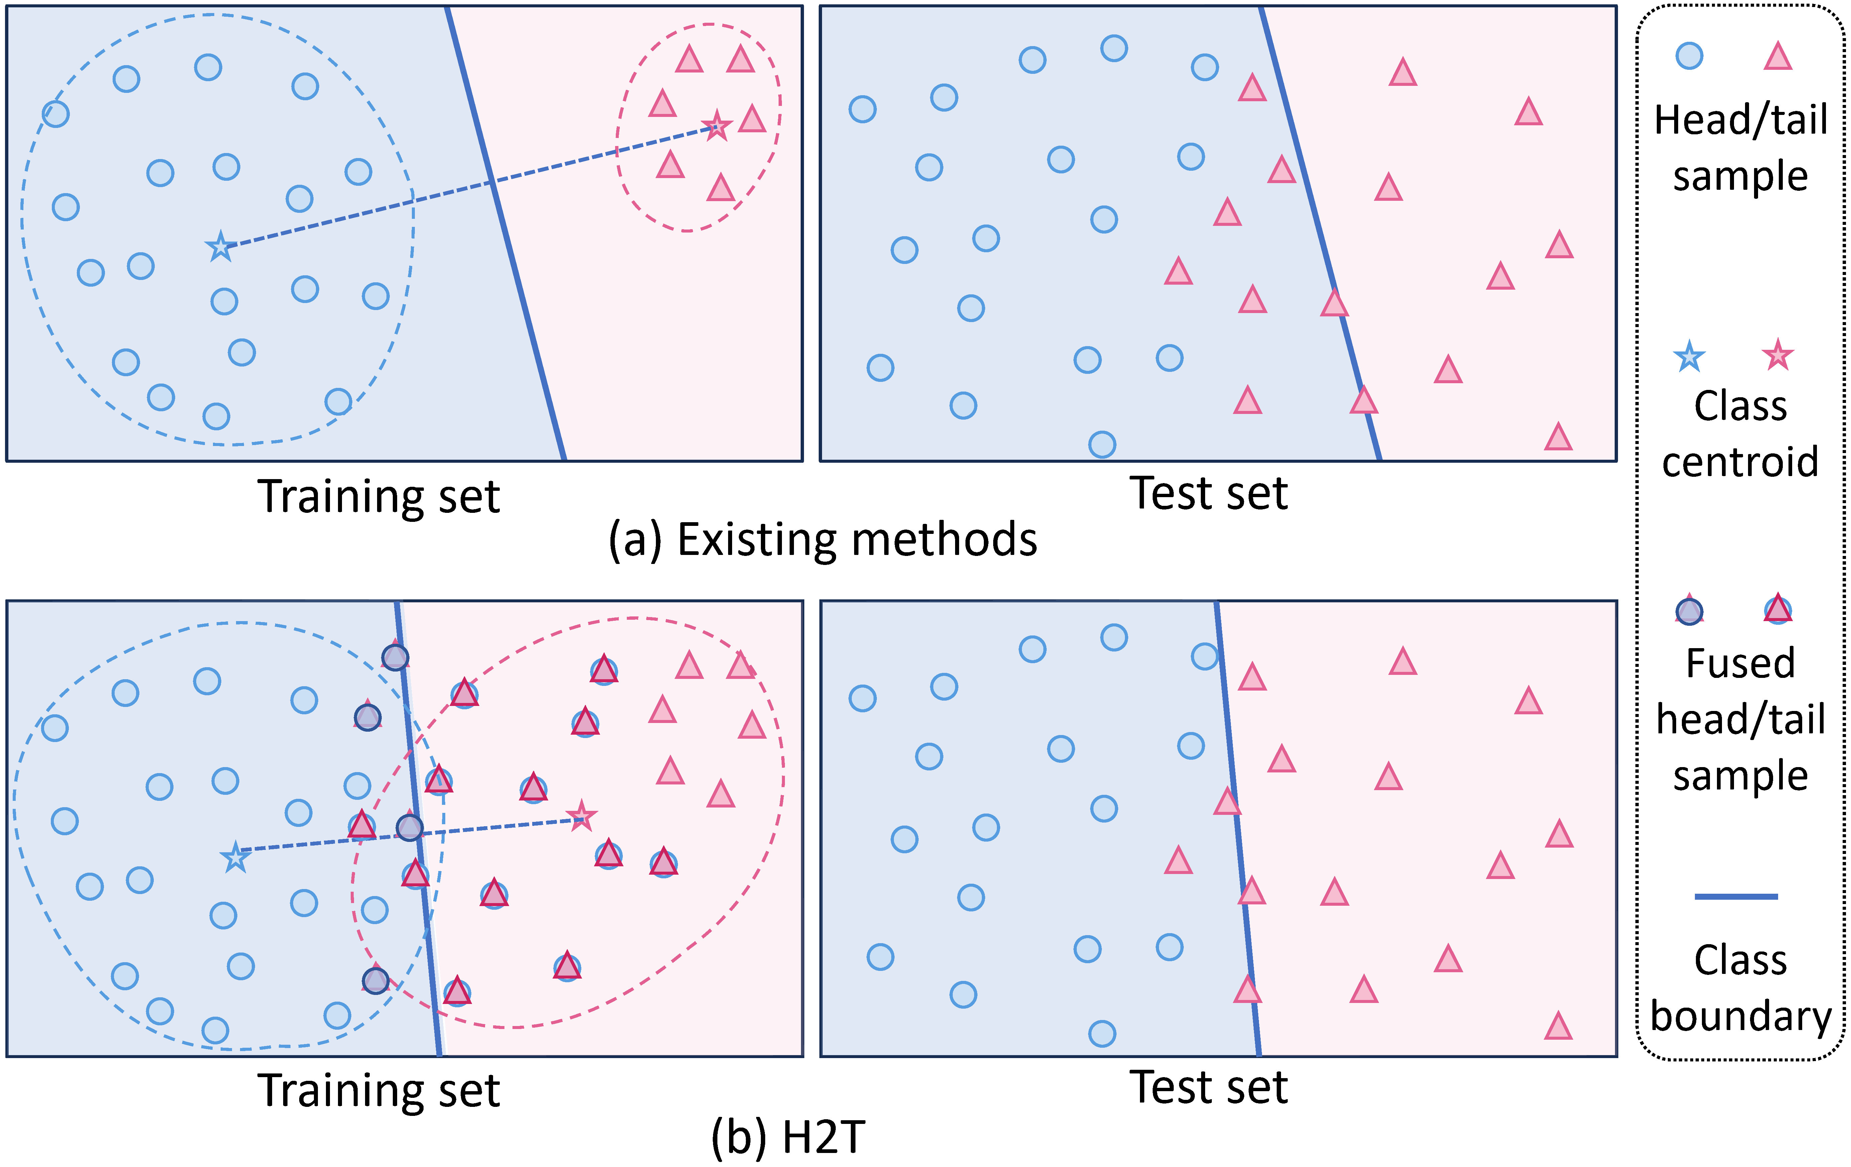
Introduction
The head class has sufficiently sampled and its embedding space is fully occupied.
The tail class suffers from a scarcity of samples, leading to sparsely distributed semantic regions.
The class boundary is biased.

Slide 3
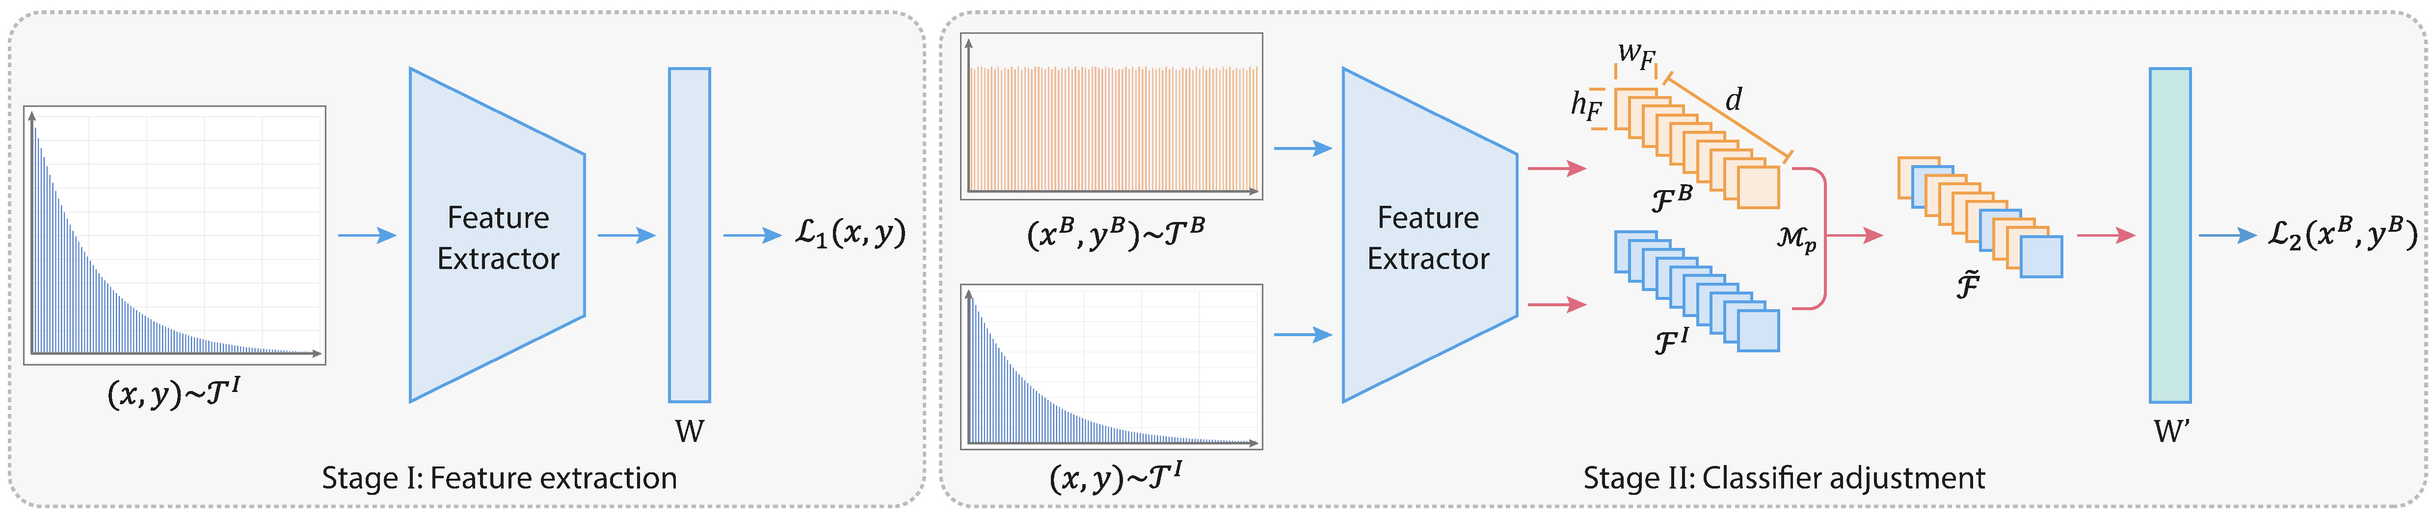
Method
Two-stage training scheme (Kang et al. 2020) .
The second stage involves dual-branch sampling: (1) fused branch -- class-balanced data ; (2) fusing branch -- instance-wise data.
Fuse the features of the two branches. Only use the labels of the fused branch as ground truth.
Kang, B.; Xie, S.; Rohrbach, M.; Yan, Z.; Gordo, A.; Feng, J.; and Kalantidis, Y. 2020. Decoupling representation and classifier for long-tailed recognition. In ICLR.

Slide 4
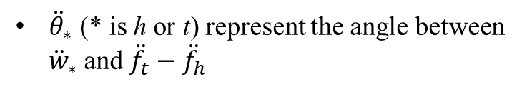
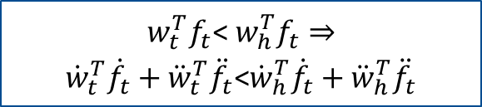
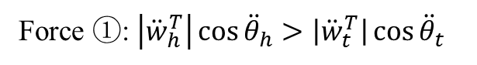
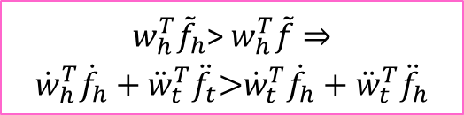
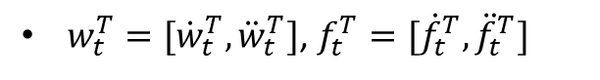
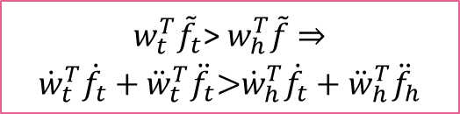
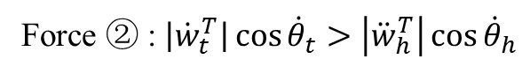
Rationale
After H2T
For tail
$w_{t}^{T}=[{\dot{w}}_{t}^{T},{\ddot{w}}_{t}^{T}]$, $f_{t}^{T}=[{\dot{f}}_{t}^{T},{\ddot{f}}_{t}^{T}]$
$$\begin{matrix}w_{t}^{T}{\tilde{f}}_{t}\text{>} w_{h}^{T}\tilde{f}⇒ \\ {\dot{w}}_{t}^{T}{\dot{f}}_{t}+{\ddot{w}}_{t}^{T}{\ddot{f}}_{t}\text{>}{\dot{w}}_{h}^{T}{\dot{f}}_{t}+{\ddot{w}}_{h}^{T}{\ddot{f}}_{h}\end{matrix}$$
${\ddot{θ}}_{∗}$ (* is h or t) represent the angle between ${\ddot{w}}_{∗}$ and ${\ddot{f}}_{t}−{\ddot{f}}_{h}$
Force ①: $\left|{\ddot{w}}_{h}^{T}\right|\cos{{\ddot{θ}}_{h}}>\left|{\ddot{w}}_{t}^{T}\right|\cos{{\ddot{θ}}_{t}}$
Before H2T
For head
$$\begin{matrix}w_{t}^{T}f_{t}\text{< }w_{h}^{T}f_{t}⇒ \\ {\dot{w}}_{t}^{T}{\dot{f}}_{t}+{\ddot{w}}_{t}^{T}{\ddot{f}}_{t}\text{<}{\dot{w}}_{h}^{T}{\dot{f}}_{t}+{\ddot{w}}_{h}^{T}{\ddot{f}}_{t}\end{matrix}$$
$$\begin{matrix}w_{h}^{T}{\tilde{f}}_{h}\text{>} w_{h}^{T}\tilde{f}⇒ \\ {\dot{w}}_{h}^{T}{\dot{f}}_{h}+{\ddot{w}}_{t}^{T}{\ddot{f}}_{t}\text{>}{\dot{w}}_{t}^{T}{\dot{f}}_{h}+{\ddot{w}}_{t}^{T}{\ddot{f}}_{h}\end{matrix}$$
Force ② : $\left|{\dot{w}}_{t}^{T}\right|\cos{{\dot{θ}}_{t}}>\left|{\ddot{w}}_{h}^{T}\right|\cos{{\dot{θ}}_{h}}$

Slide 5
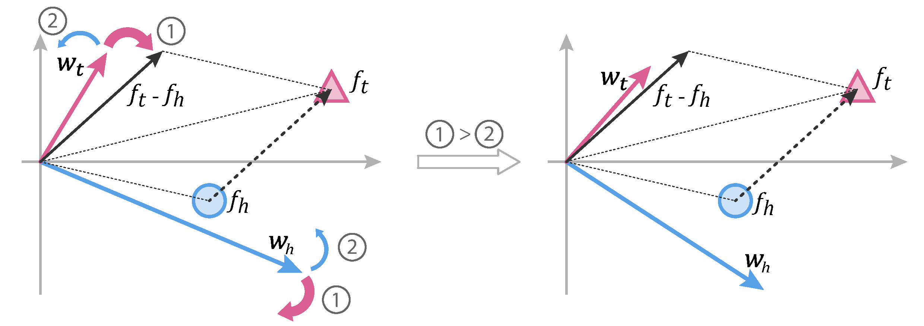
Rationale
Forces ①>② makes the tail sample to “pull” closer to and “push” further away from $w_{h}$, leading to the adjustment of decision boundary and enlargement of the tail class space.

Slide 6
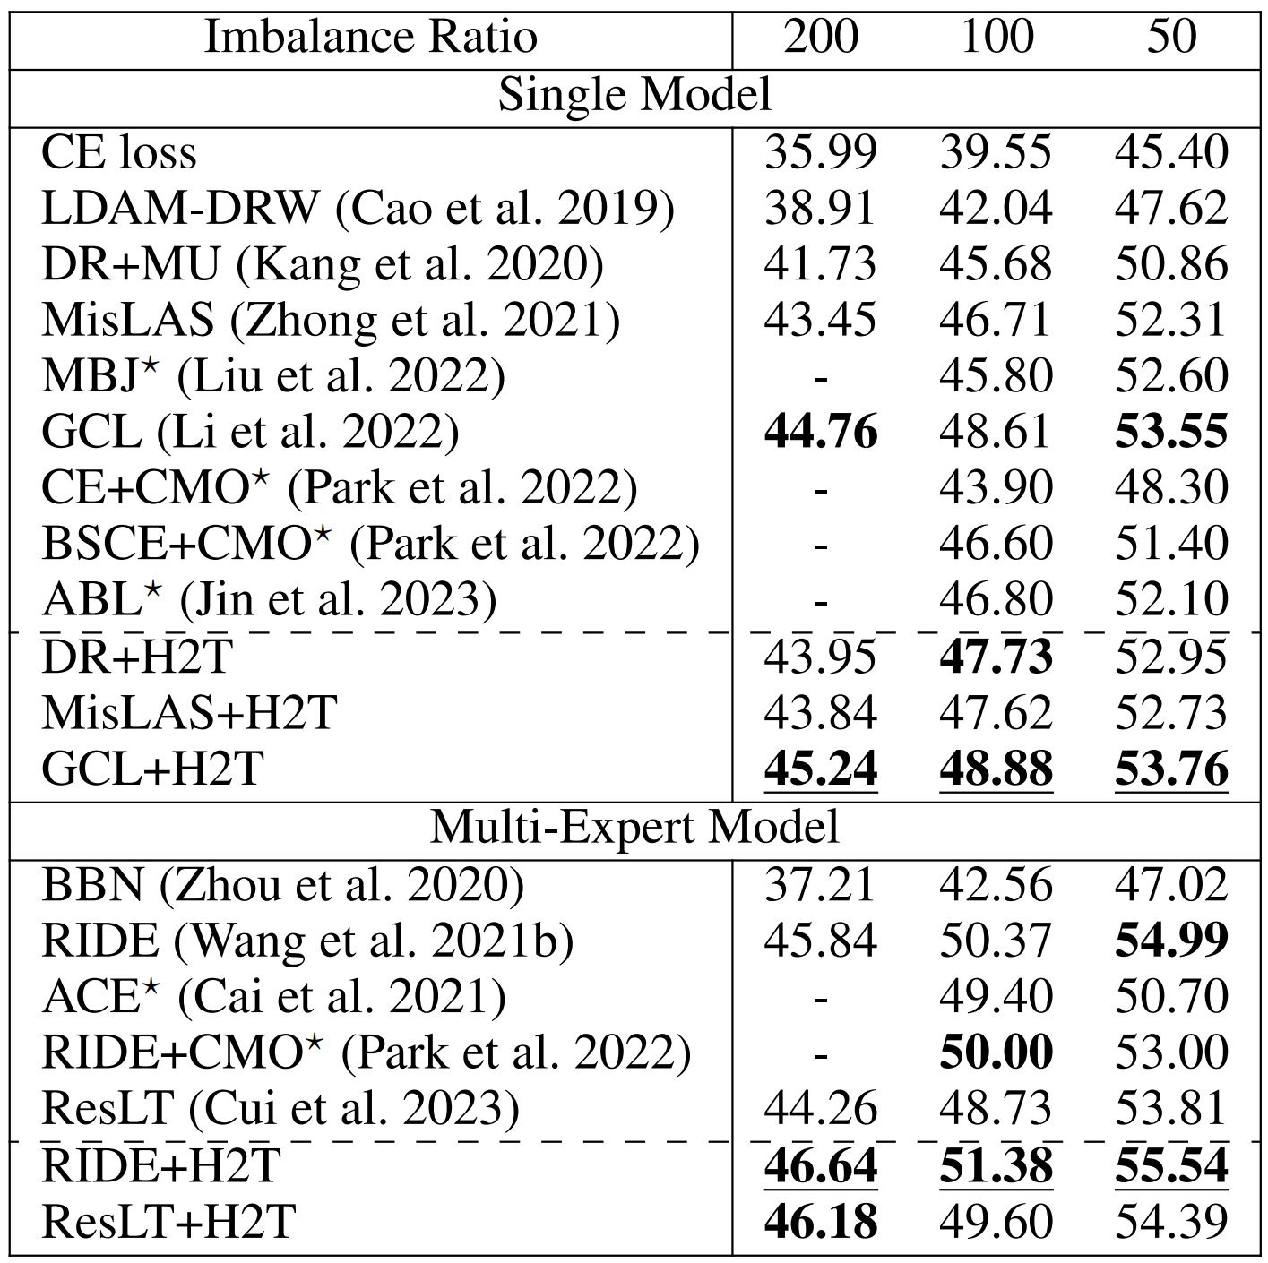
Experiments
Comparison results on CIFAR100-LT

Slide 7
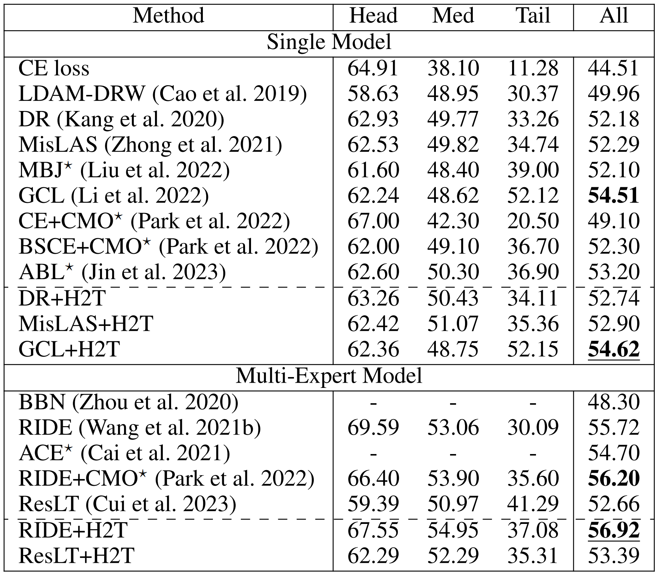
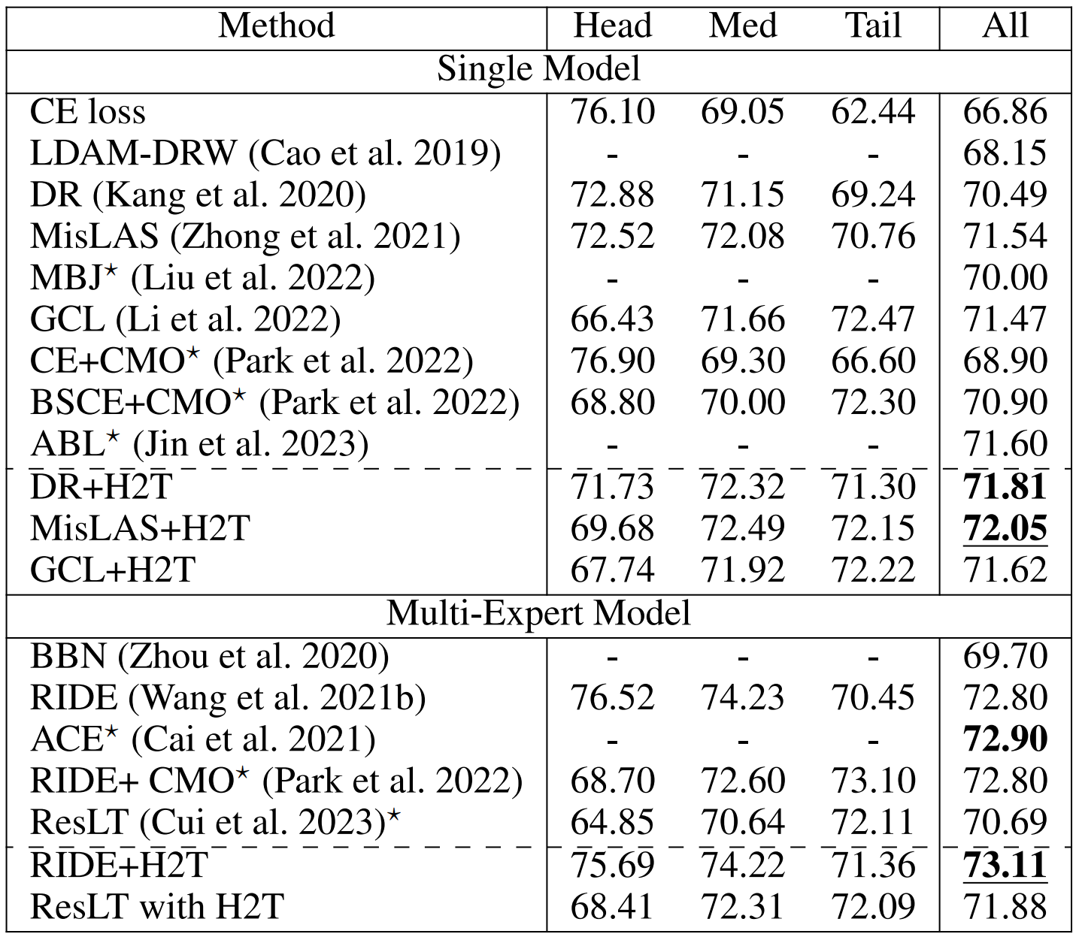
Experiments
Comparison results on imageNet-LT and iNaturalist 2018

Slide 8
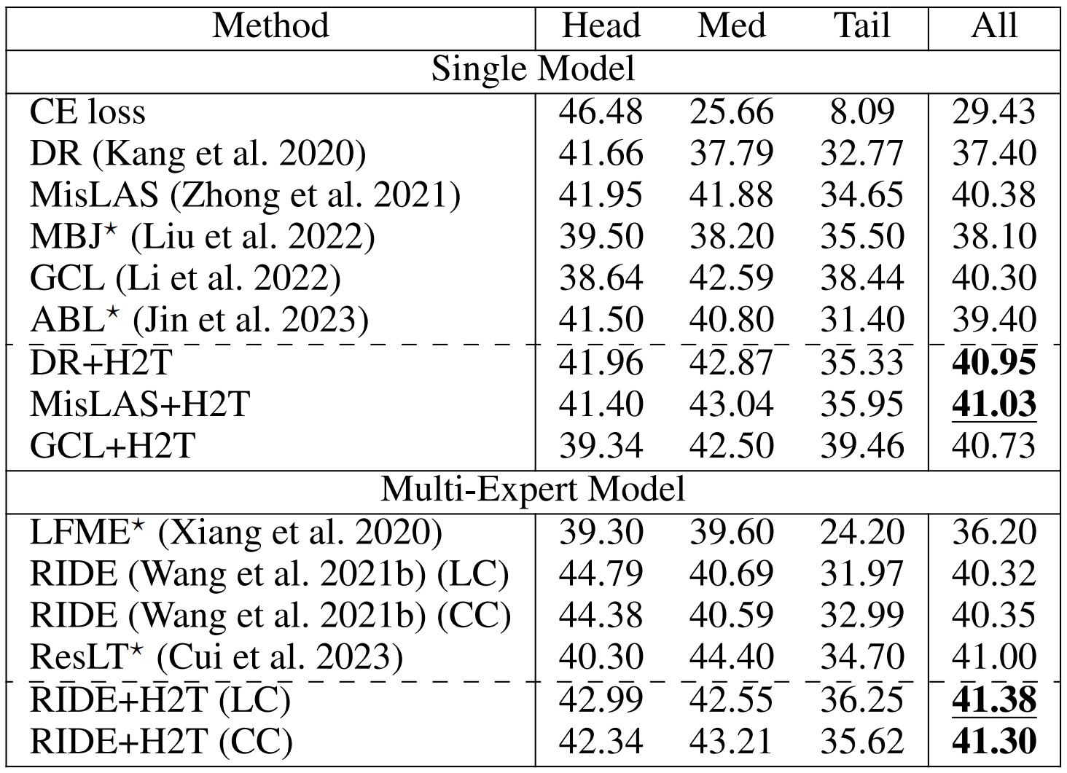
Experiments
Comparison results on Places-LT. CC, cosine classifier. LC, linear classifier.

Slide 9
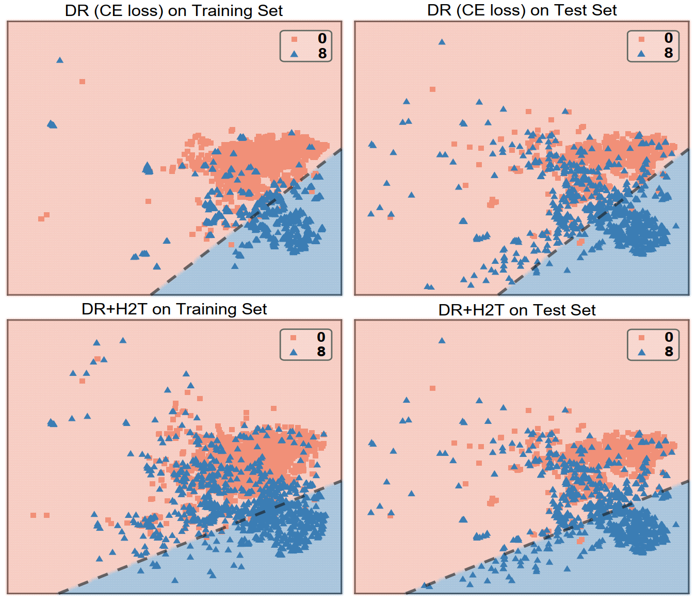
Experiments
Decision boundary comparison

Slide 10
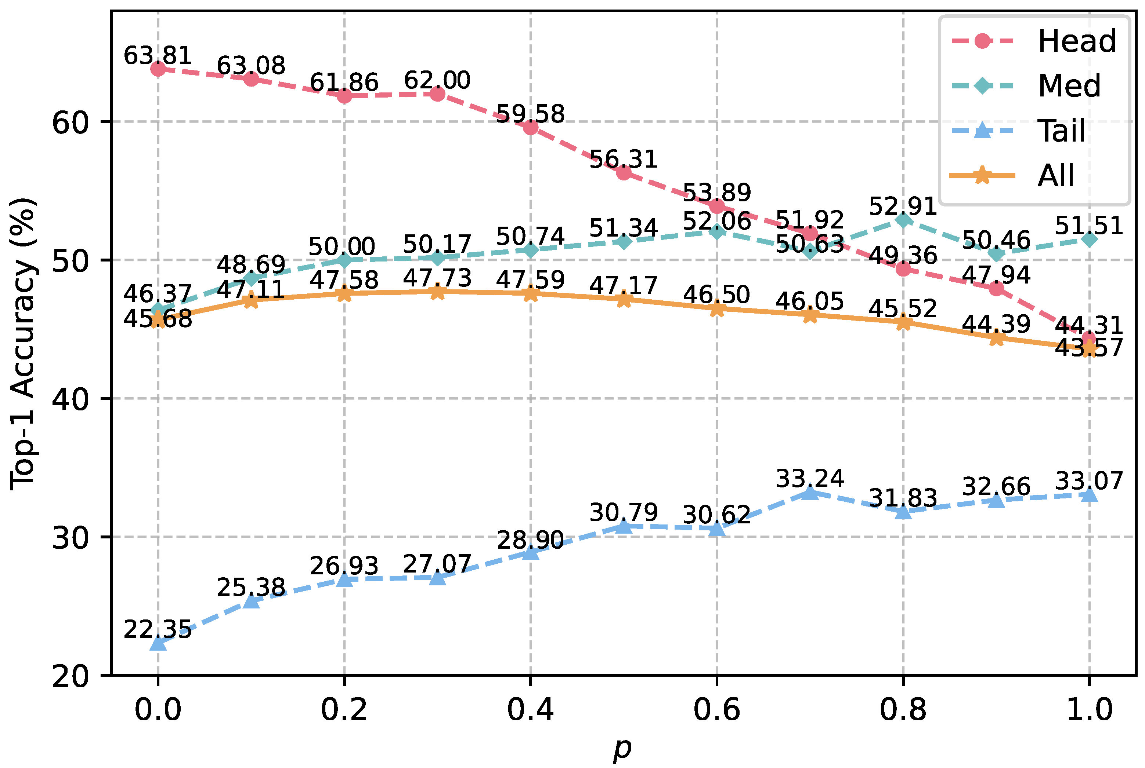
Experiments
Change of accuracy (%) on different splits w.r.t. fusing ratio p.

Slide 11
Conclusion
Pros:
Simple but effective:
A plug-and-play module;
H2T produces abundant features to augment tail classes;
H2T generates two opposing forces that restrain each other, preventing excessive sacrifices in head class accuracy.
Cons:
Sacrifice head class performance:
H2T only adjusts the decision boundary without altering the feature distribution.

Slide 12





Thanks
AAAI 2024

